Slide 1
Supernova’s Alexa
Team
Abigail Wahl - Product
Aisha Azmat - Business
Kanchan Sharma - Architecture
Vikash Deo - Developer

Slide 2
Introduction
Problem: Attending clients/visitors at the reception can get very busy
Solution: Team Supernova’s Alexa skill as a virtual assistant

Slide 3
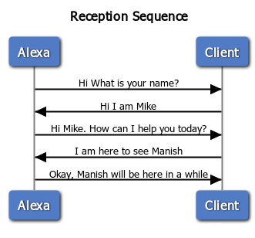
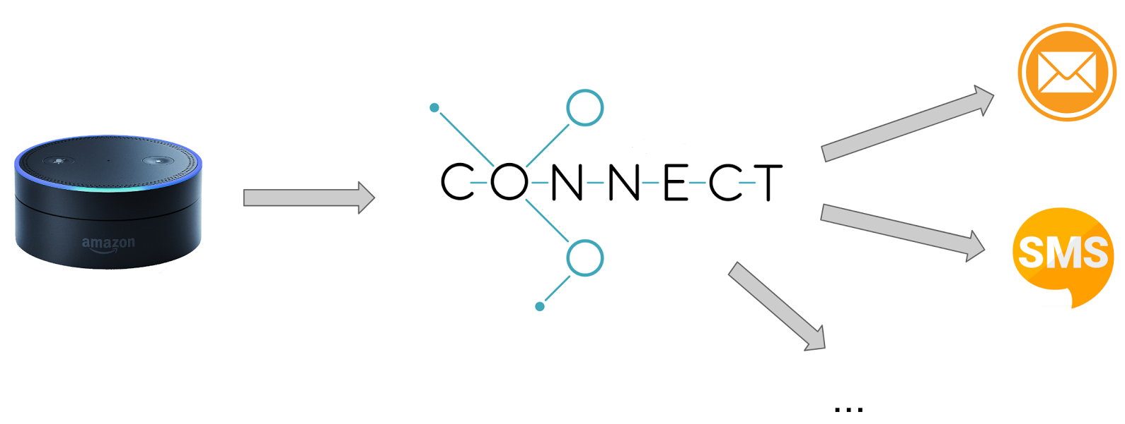
Product
How it works

Slide 4

Business
Amazon’s Alexa could bring the U.S. e-commerce giant $10 billion of revenue by 2020, according to RBC Capital Markets.

Slide 5
Technology
Github Repo: GIthub Repo
Python Flask
ngrok
Twilio API
Amazon Echo Simulator

Slide 6
Future
Flight check-in
Hotel check-in
Movie tickets
Doctor’s appointment

